Slide 1
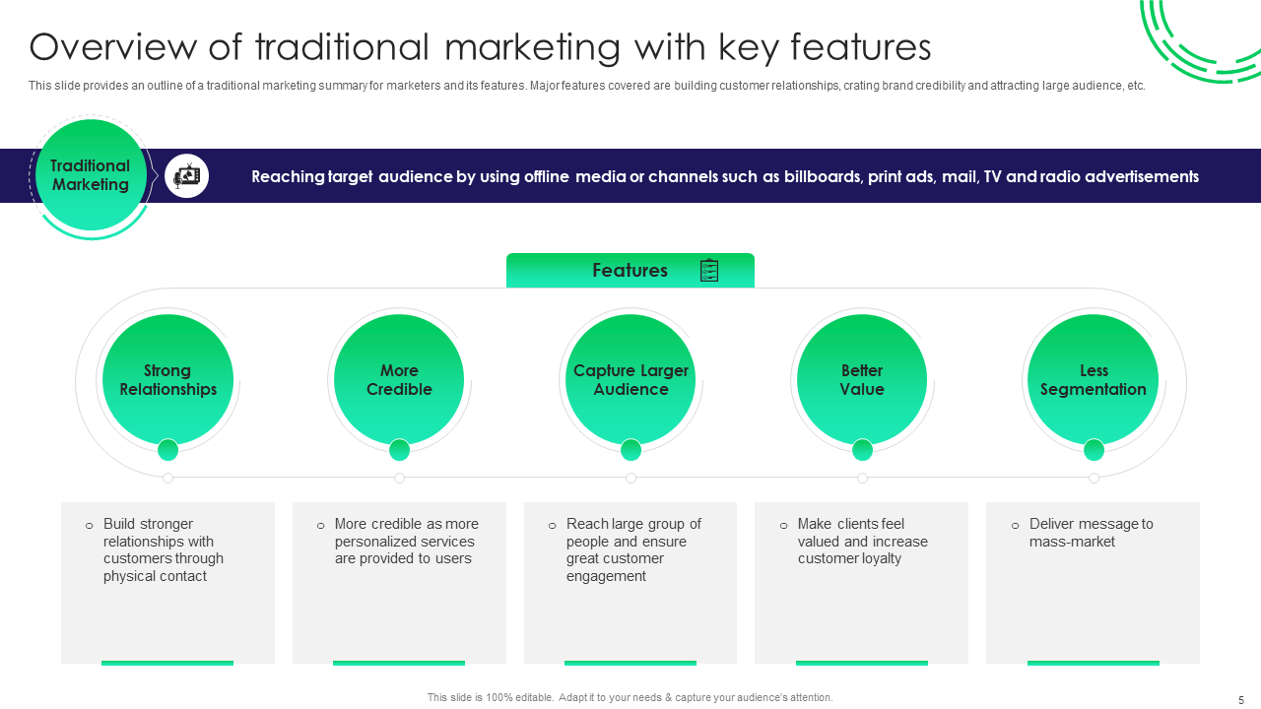
Click here to Download the Editable Version!

Slide 2

Click here to Download the Editable Version!

Slide 3

Click here to Download the Editable Version!

Slide 4
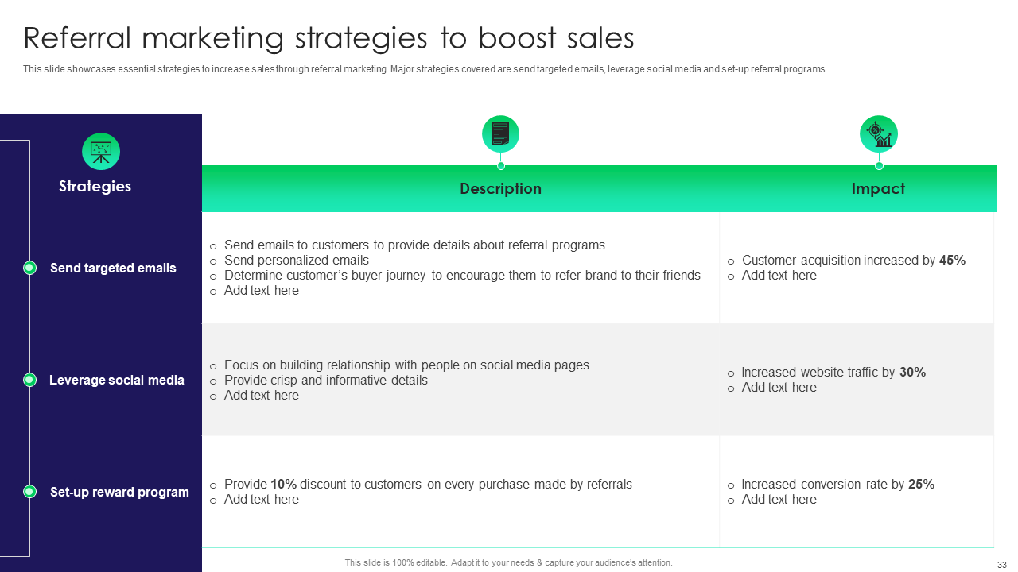
Click here to Download the Editable Version!

Slide 5
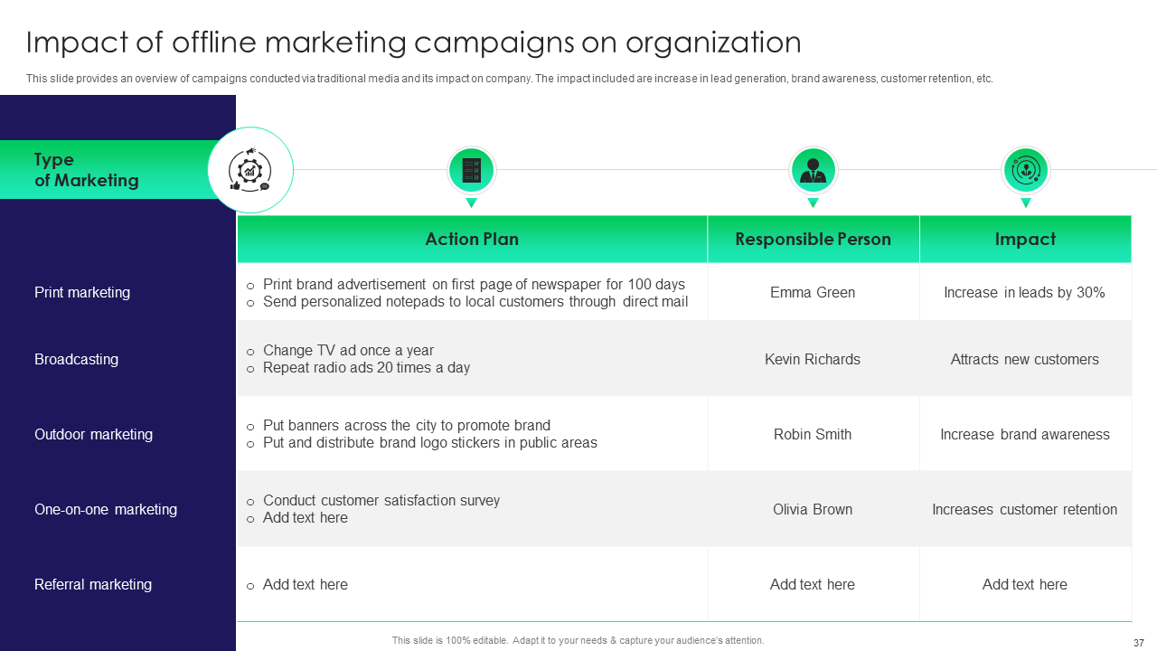
Click here to Download the Editable Version!

Slide 6

Click here to Download the Editable Version!

Slide 7

Click here to Download the Editable Version!

Slide 8

Click here to Download the Editable Version!

