Slide 1

Click Here to Get the Editable Version

Slide 2
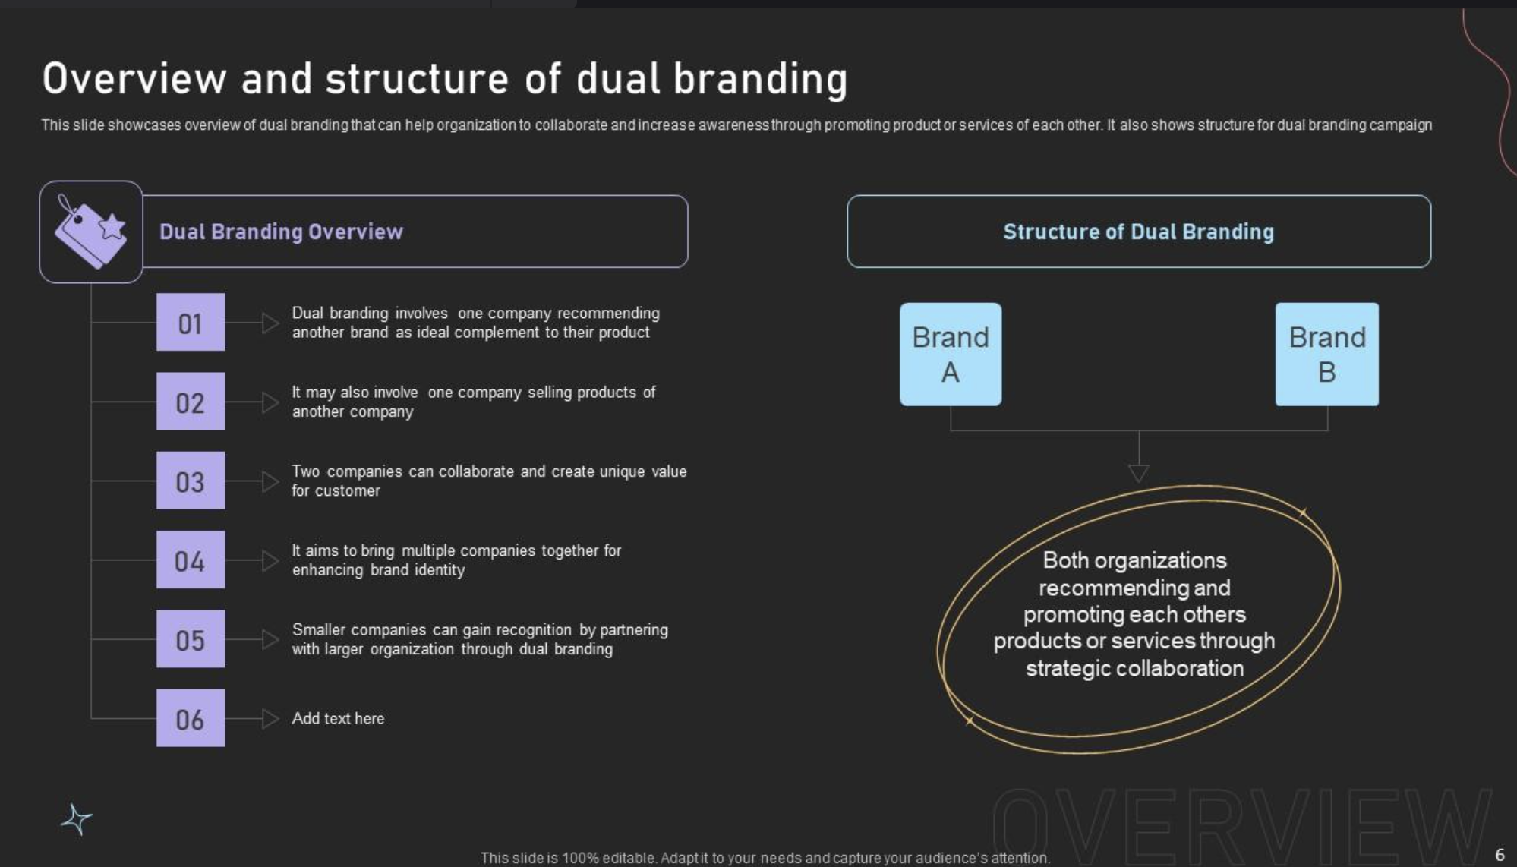
Click Here to Get the Editable Version

Slide 3
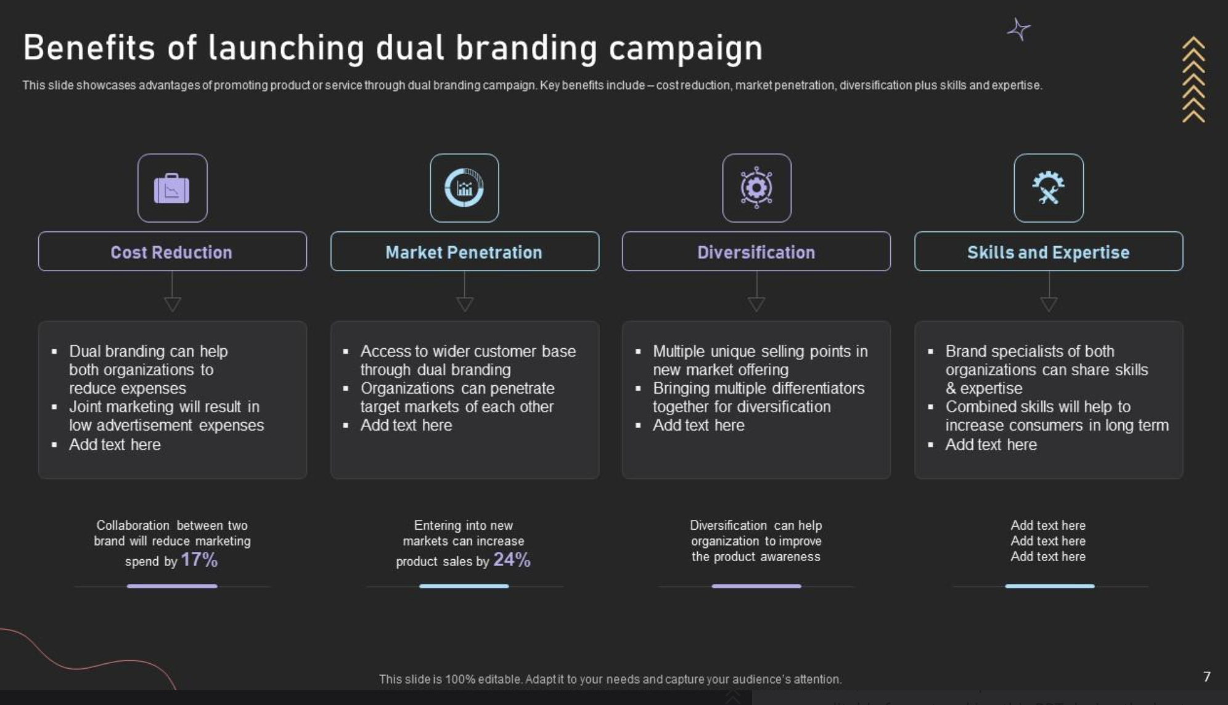
Click Here to Get the Editable Version

Slide 4
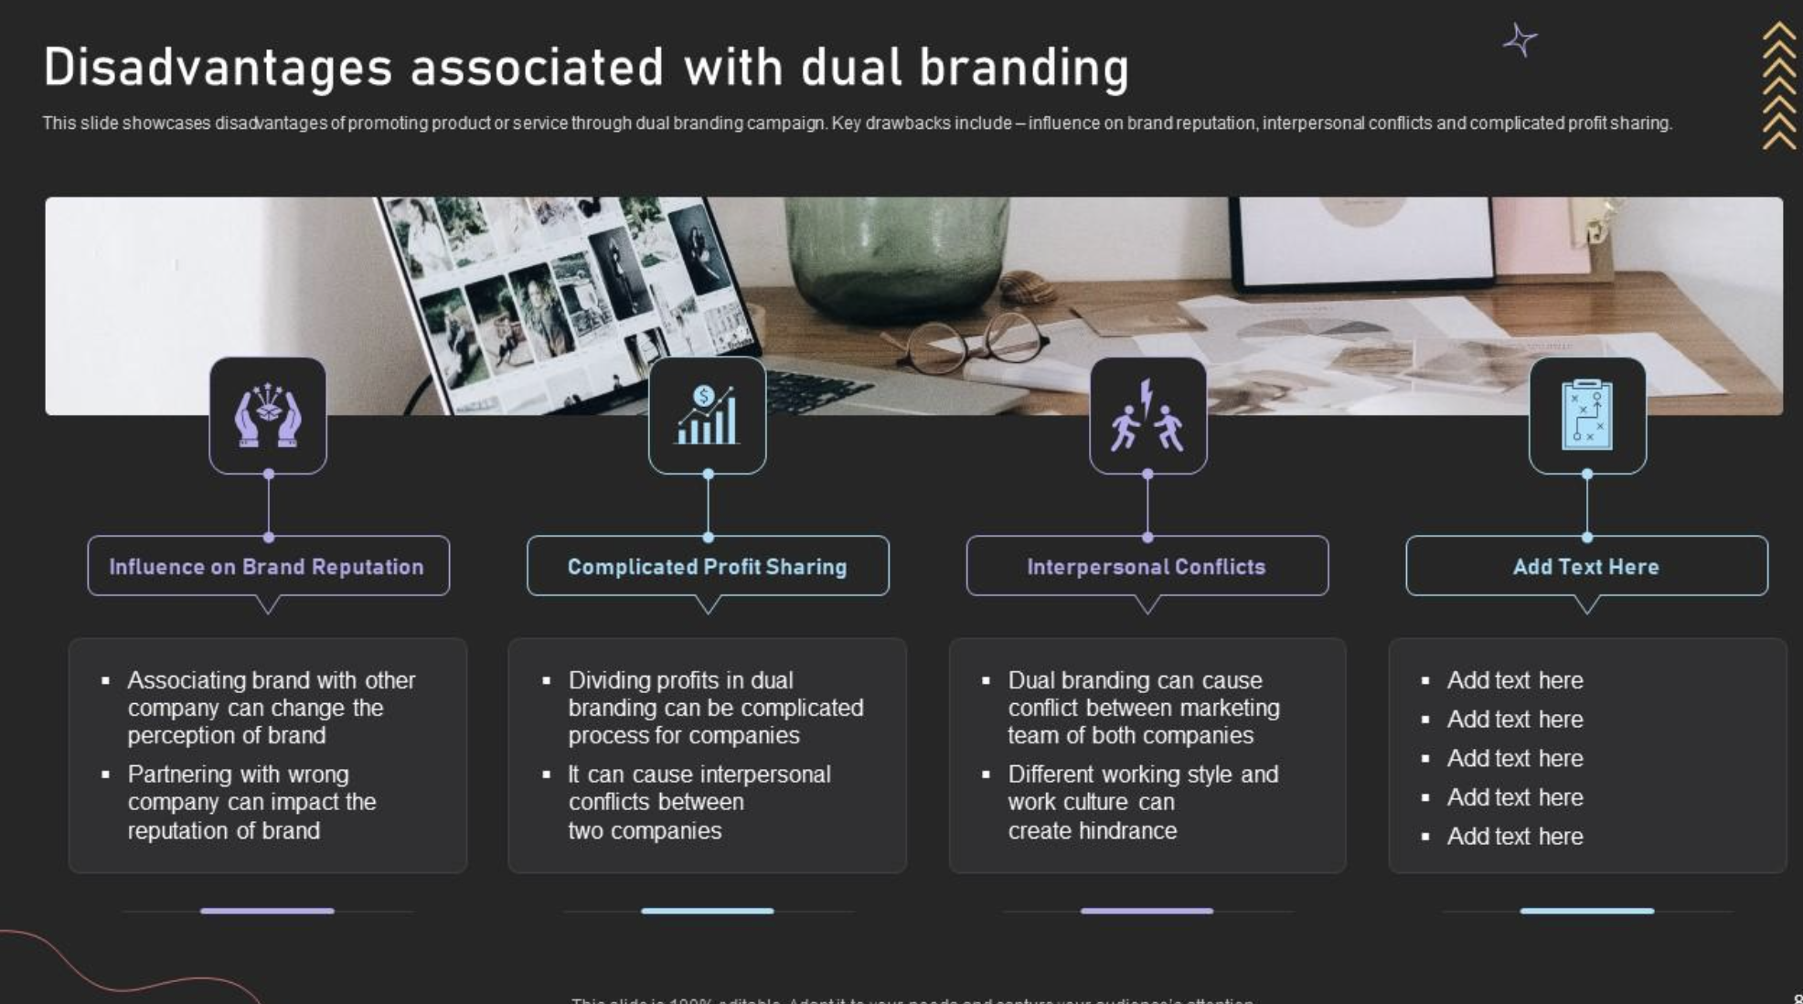
Click Here to Get the Editable Version

Slide 5
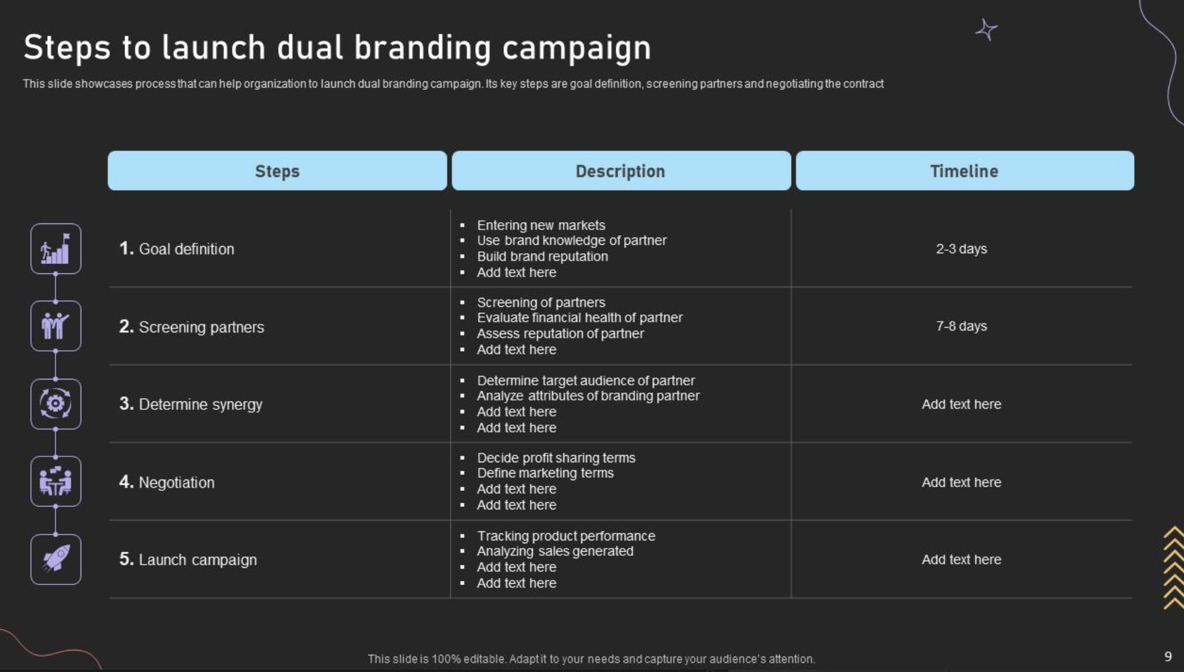
Click Here to Get the Editable Version

Slide 6
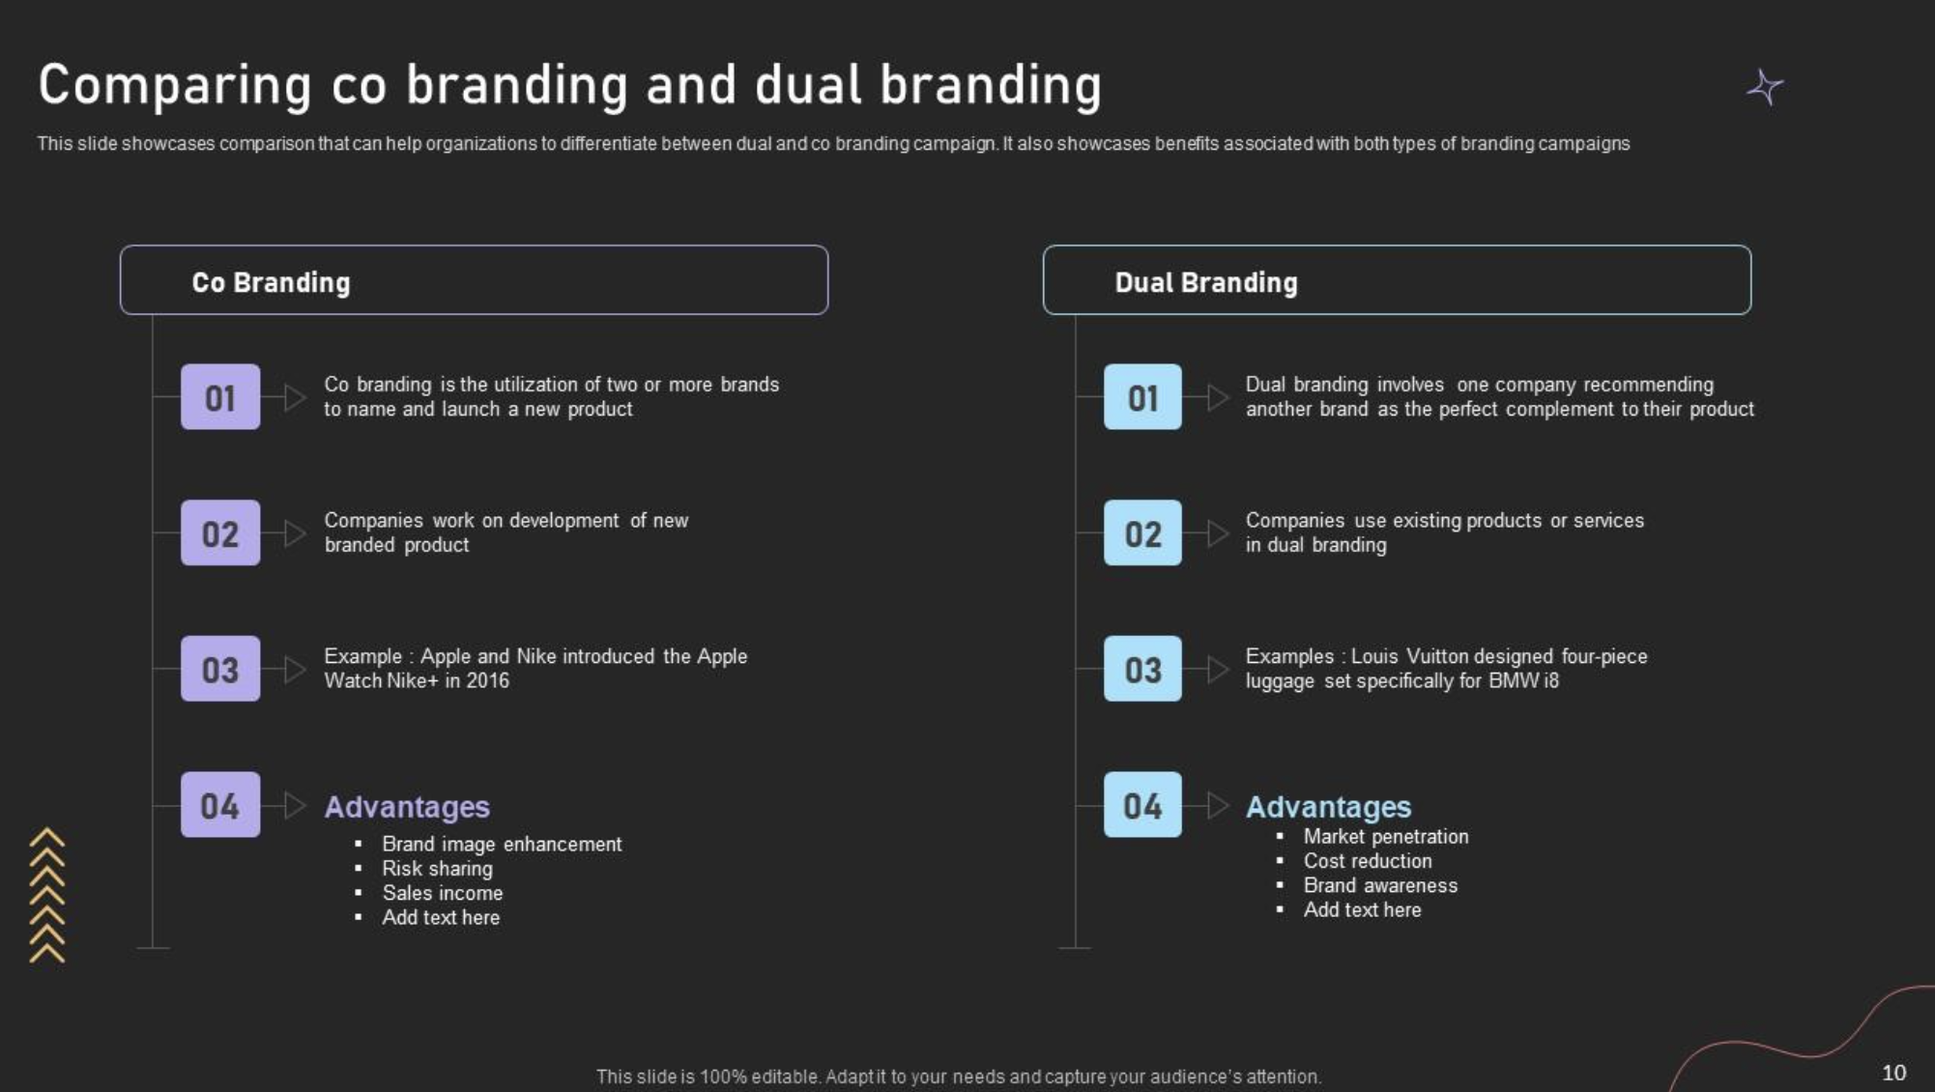
Click Here to Get the Editable Version

