Slide 1
Click Here to Download the Editable Version!

Slide 2
Click Here to Download the Editable Version!

Slide 3
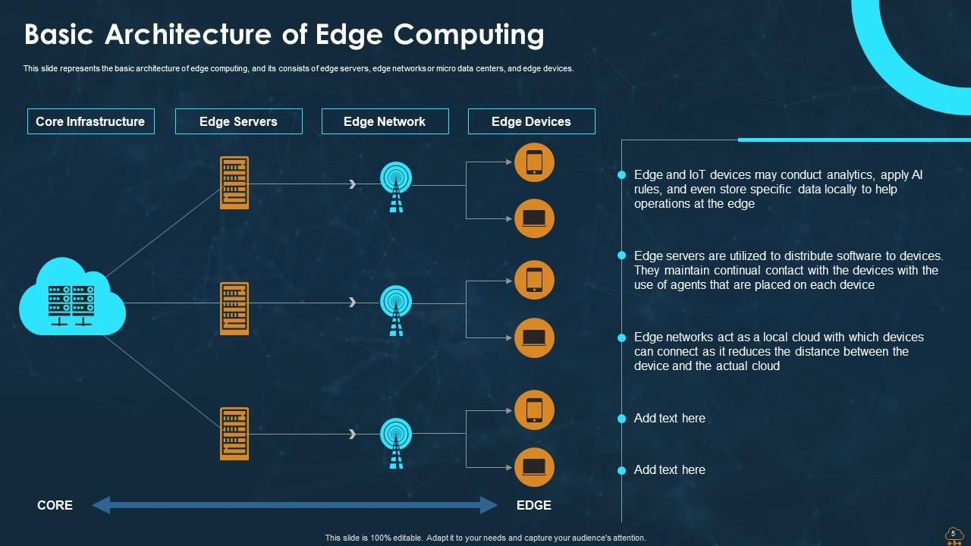
Click Here to Download the Editable Version!

Slide 4
Click Here to Download the Editable Version!

Slide 5
Click Here to Download the Editable Version!

Slide 6
Click Here to Download the Editable Version!

