Slide 1
Click on the Link to Download Editable Version

Slide 2
Click on the Link to Download Editable Version

Slide 3
Click on the Link to Download Editable Version

Slide 4
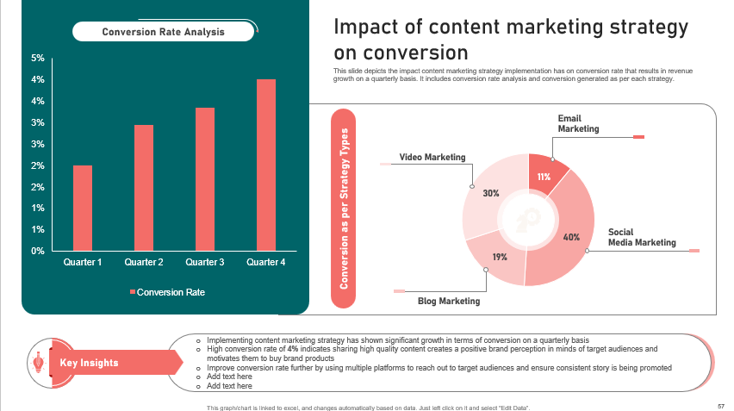
Click on the Link to Download Editable Version

