Slide 1
Click on the link to download editable version

Slide 2
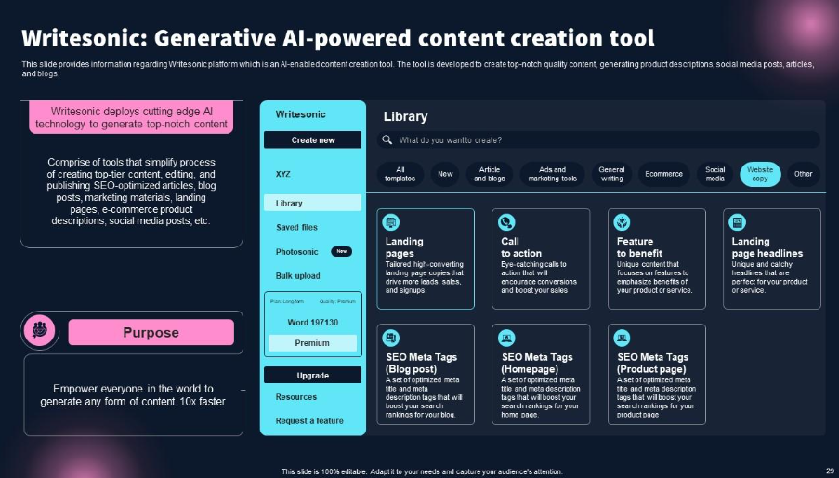
Click on the link to download editable version

Slide 3
Click on the link to download the editable version

