Slide 1


Slide 2
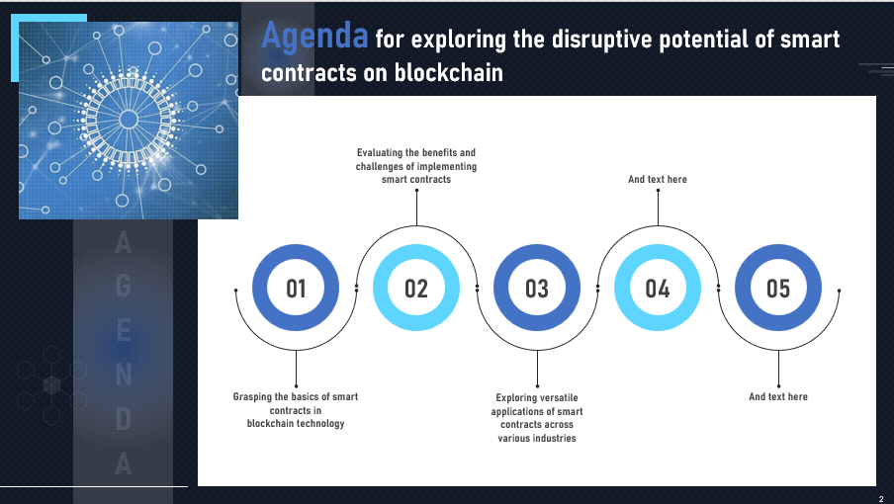
Click on the link to Download the PPT

Slide 3
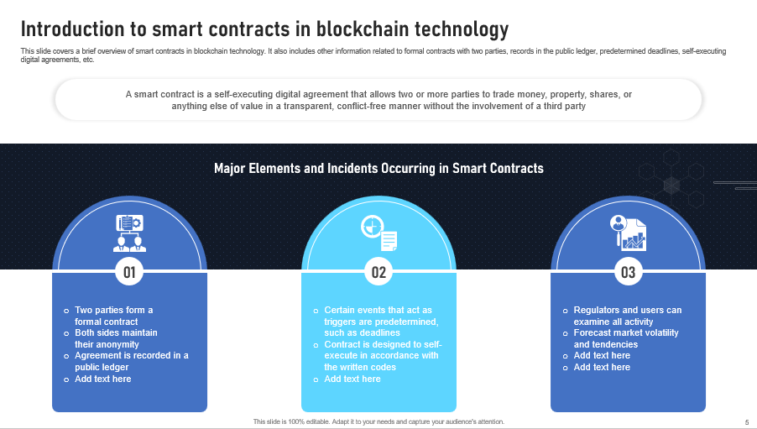
Click on the link to Download the PPT

Slide 4
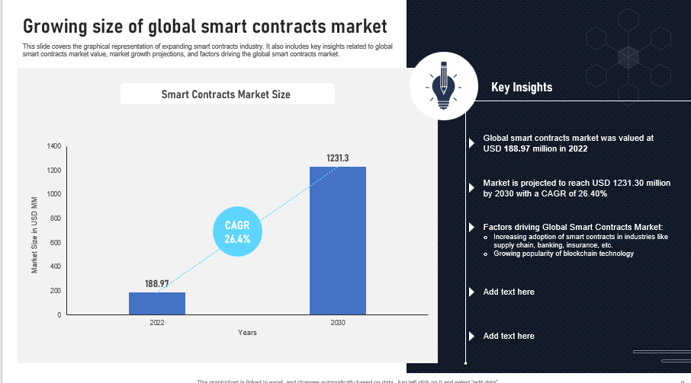
Click on the link to Download the PPT

Slide 5


