Slide 1
Comprehensive Guide to Use and Edit this PowerPoint Deck
C

Slide 4
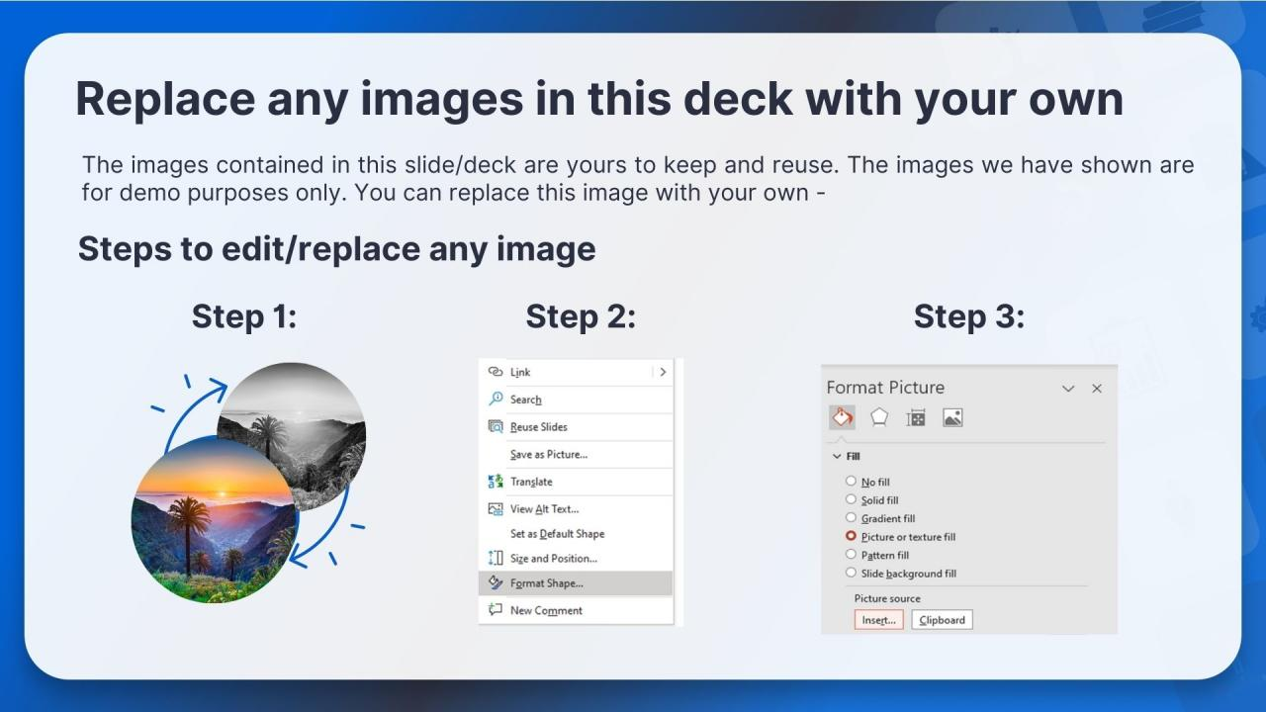

Slide 5
ICONS BUNDLE.

Slide 8
support@slideteam.net
+1-408-659-4170
www.slideteam.net

