Slide 1

Download this Template!

Slide 2

Download this Template!

Slide 3

Download this Template!

Slide 4

Download this Template!

Slide 5
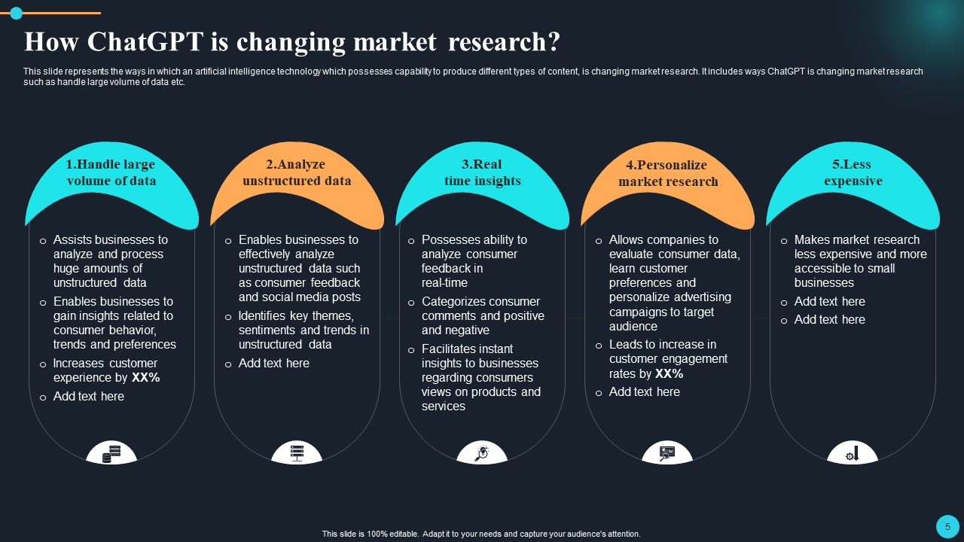
Download this Template!

Slide 6
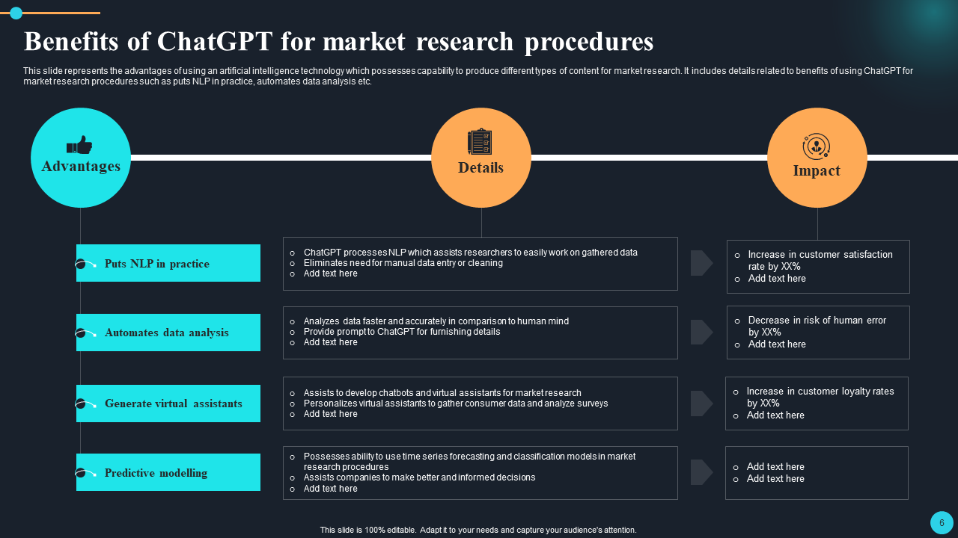
Download this Template!

Slide 7
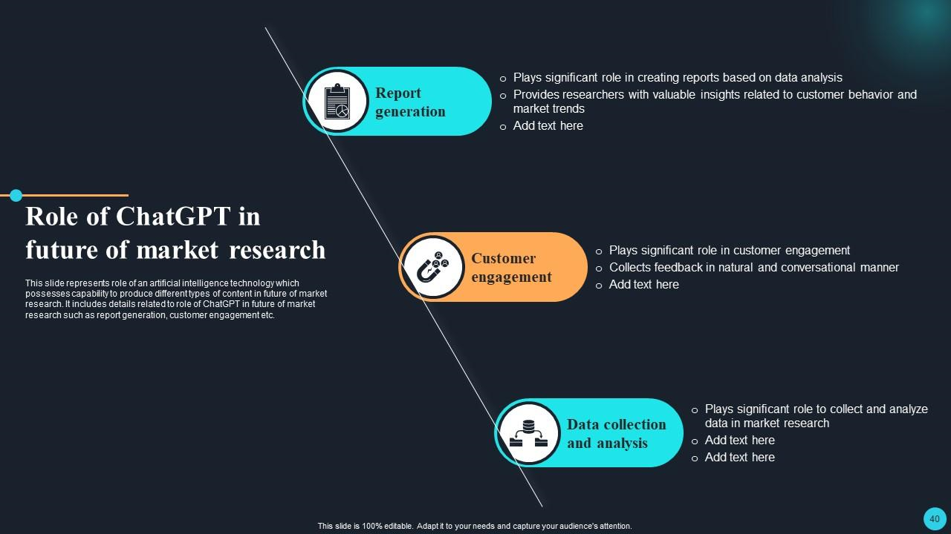
Download this Template!

Slide 8

Download this Template!

