Slide 1


Slide 2
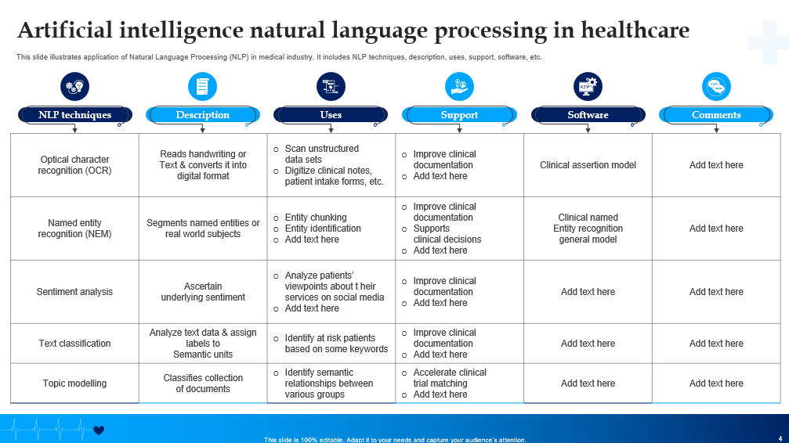
Click on the Link to Download Editable PPT

Slide 3
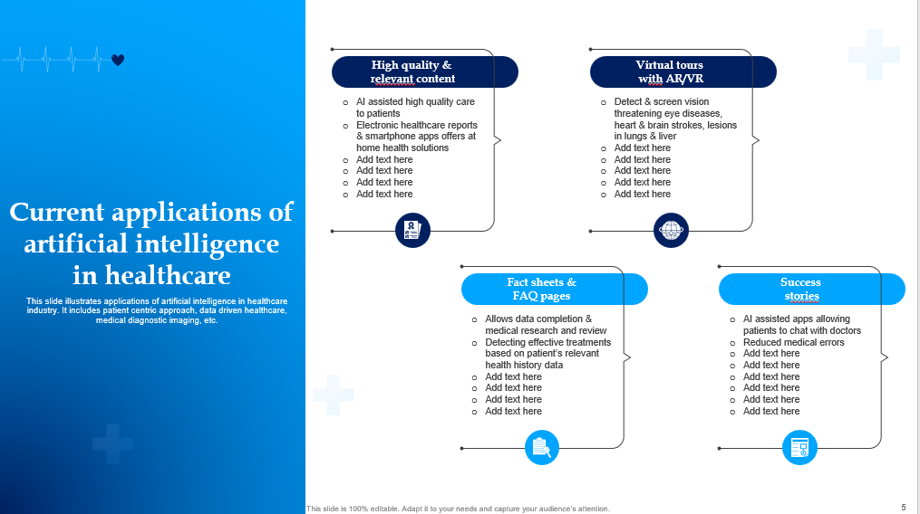
Click on the Link to Download Editable PPT

Slide 4
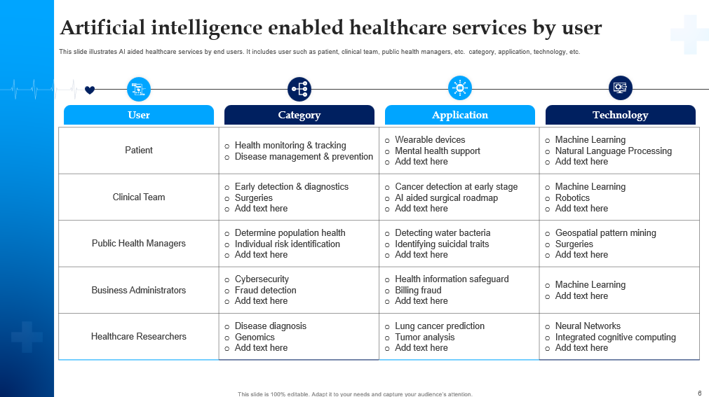
Click on the Link to Download Editable PPT

Slide 5


