Slide 1

Click here to get an editable version.

Slide 2
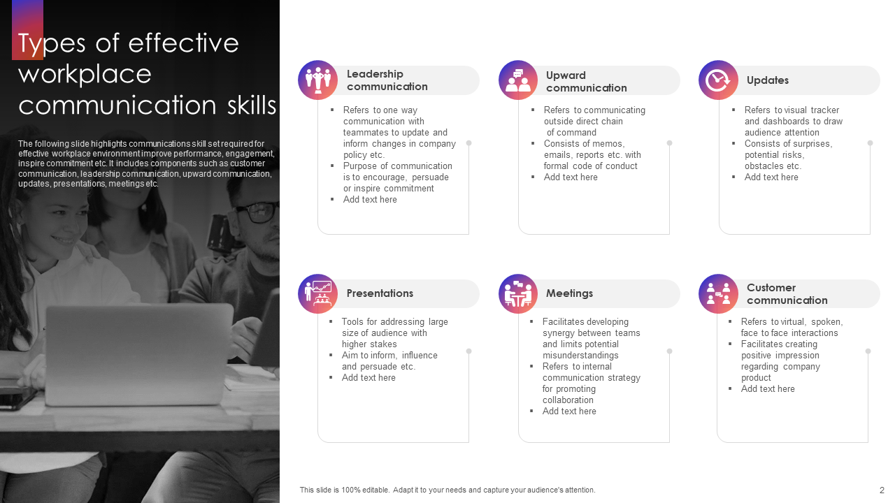
Click here to get an editable version.

Slide 3
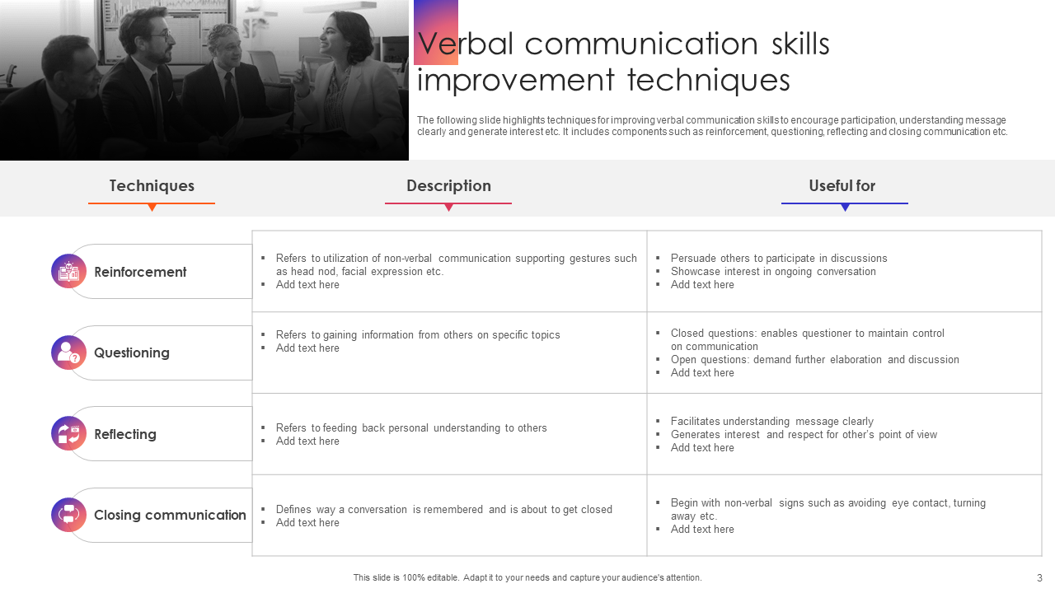
Click here to get an editable version.

Slide 4
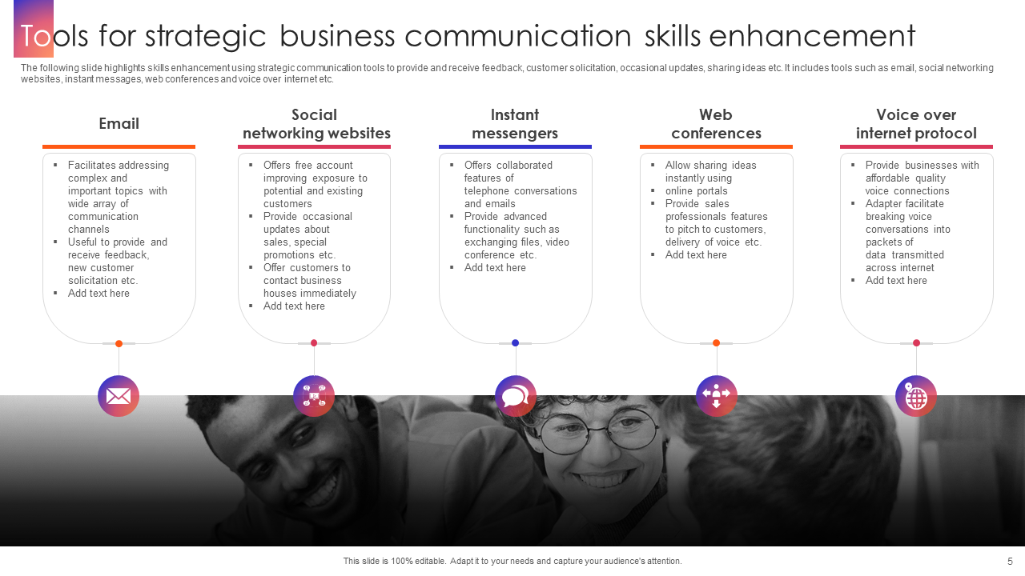
Click here to get an editable version.

Slide 5

Click here to get an editable version.

