Slide 1
Click Here to Get the Editable Version

Slide 2
Click Here to Get the Editable Version

Slide 3
Click Here to Get the Editable Version

Slide 4
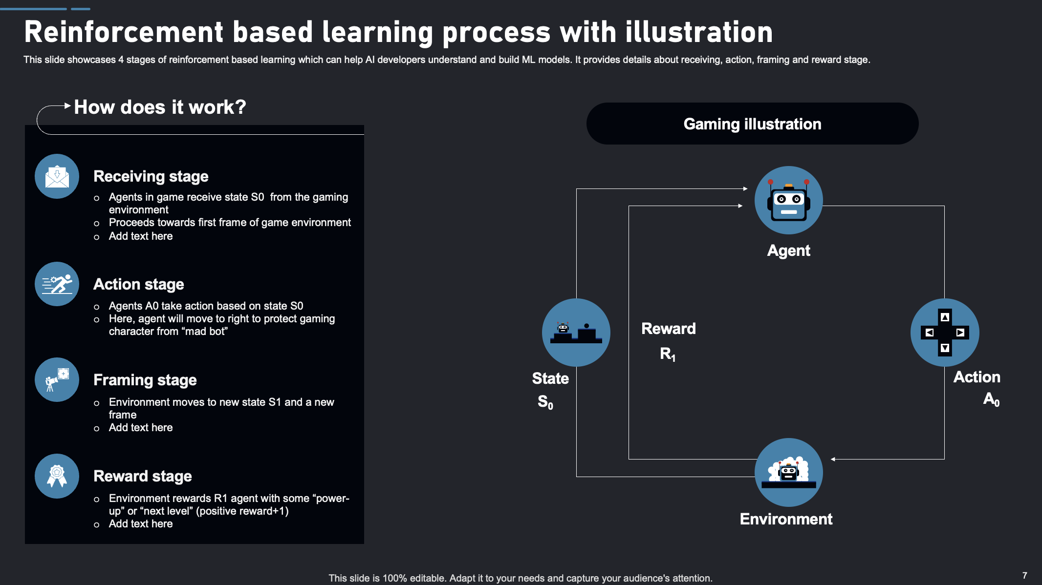
Click Here to Get the Editable Version

Slide 5
Click Here to Get the Editable Version

