Slide 1
Download this Template!

Slide 2
Download this Template!

Slide 3
Download this Template!

Slide 4
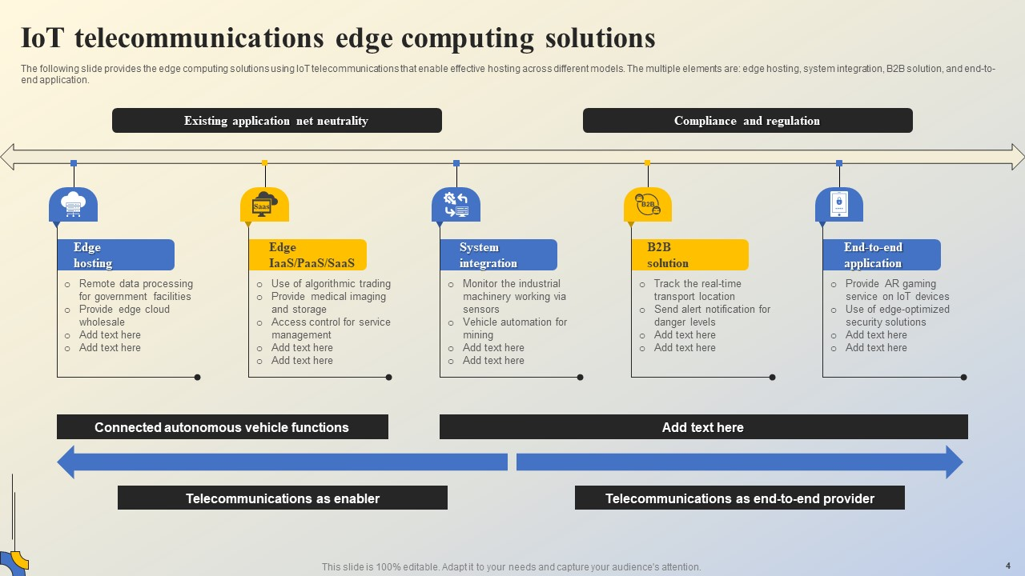
Download this Template!

Slide 5
Download this Template!

Slide 6
Download this Template!

Slide 7
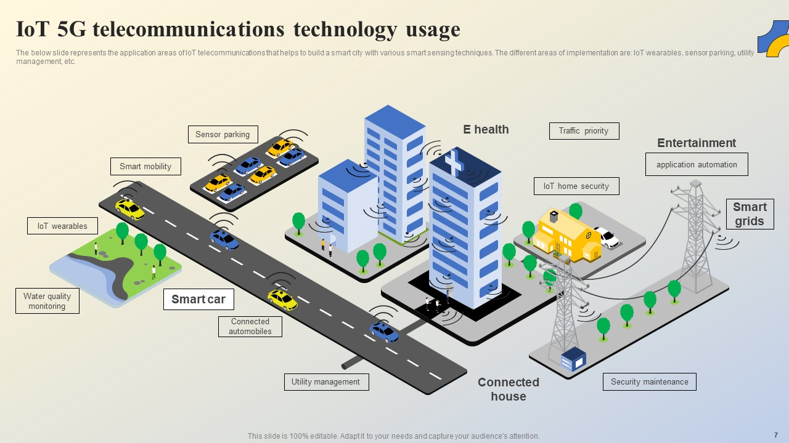
Download this Template!

