Slide 1
Click Here to Download the Editable Version!

Slide 2
Click Here to Download the Editable Version!

Slide 3
Click Here to Download the Editable Version!

Slide 4
Click Here to Download the Editable Version!

Slide 5
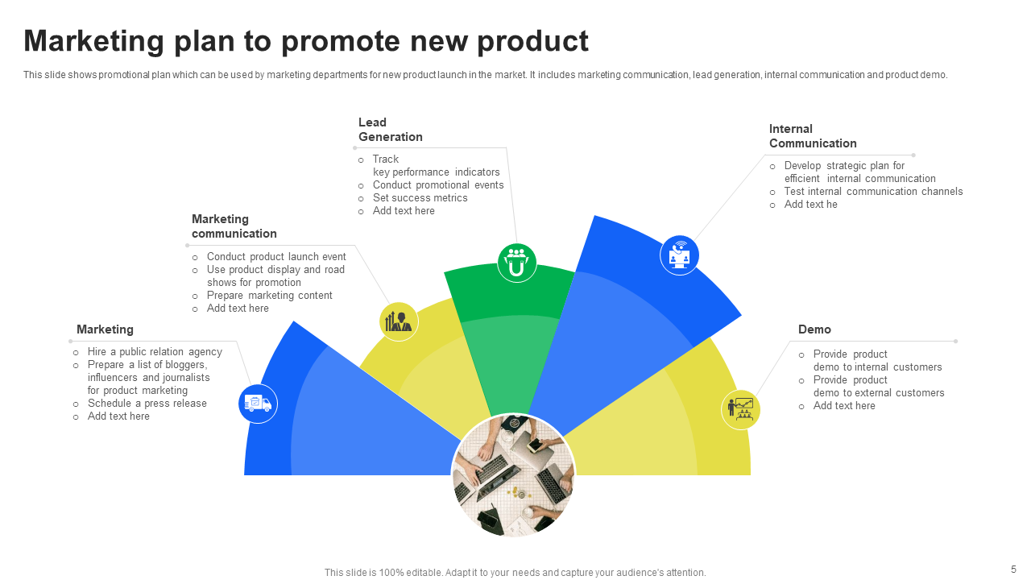
Click Here to Download the Editable Version!

Slide 6
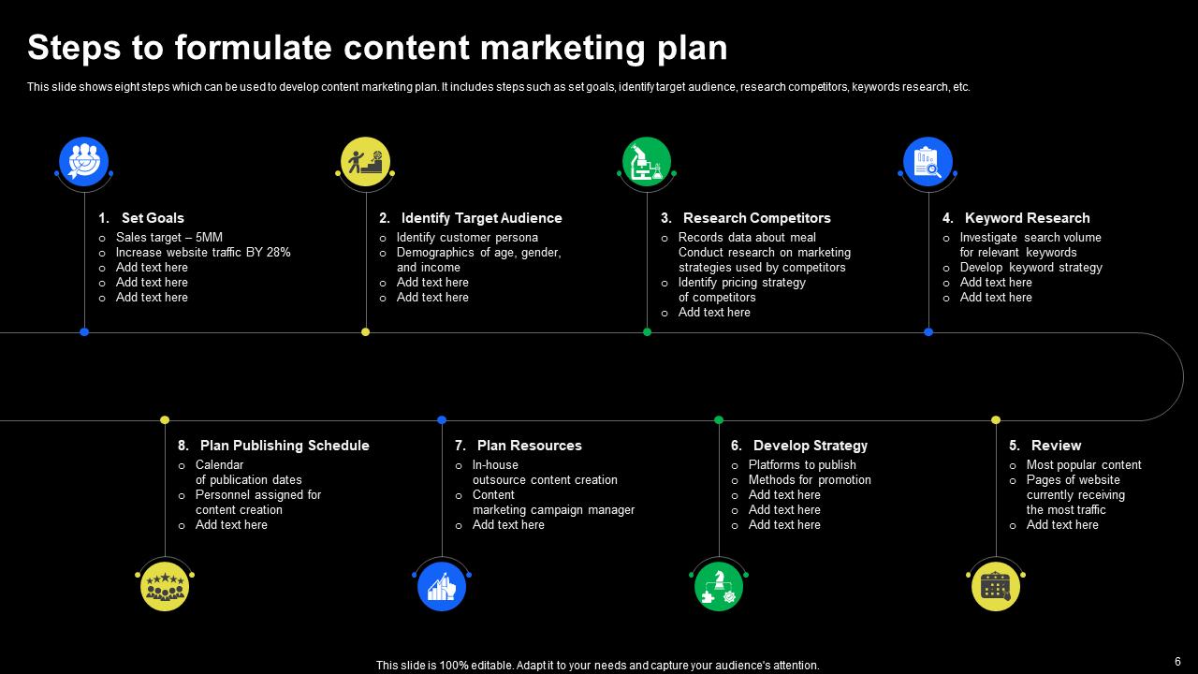
Click Here to Download the Editable Version!

Slide 7
Click Here to Download the Editable Version!

Slide 8
Click Here to Download the Editable Version!

