Slide 1
Click Here to Download the Editable Version!

Slide 2
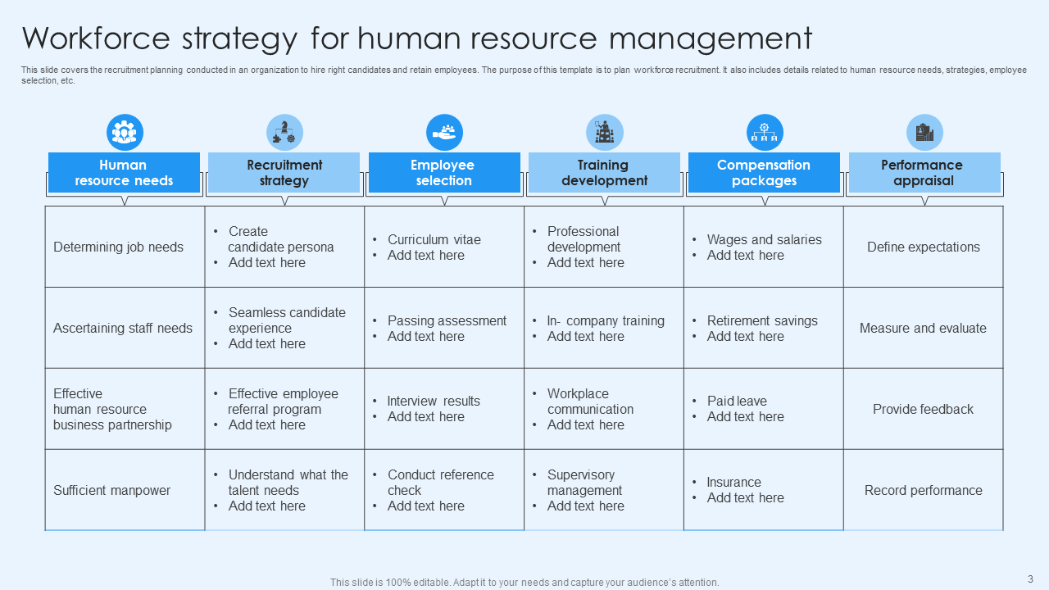
Click Here to Download the Editable Version!

Slide 3
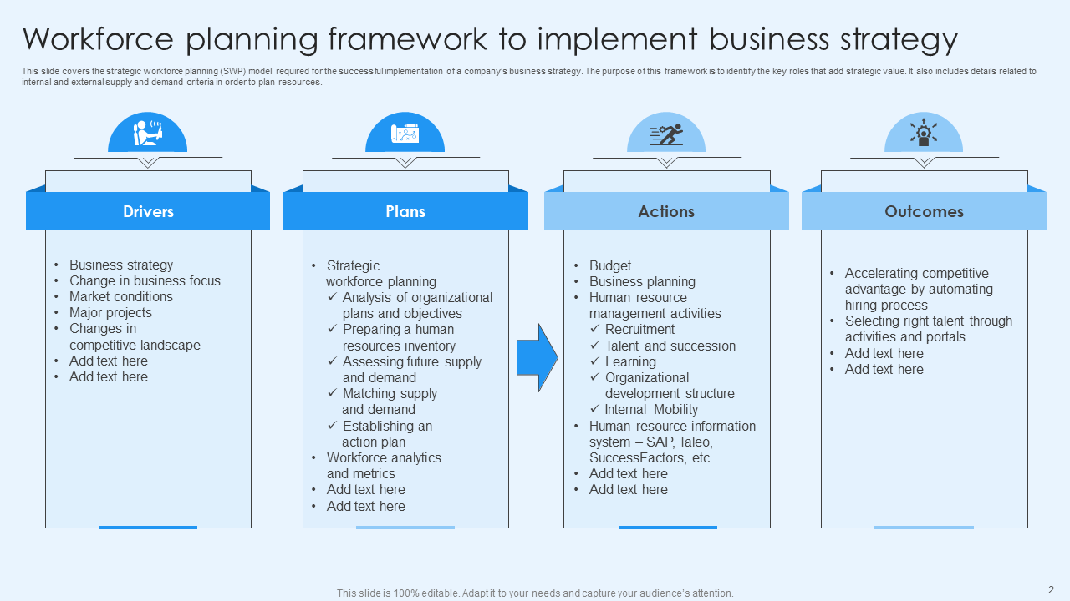
Click Here to Download the Editable Version!

Slide 4
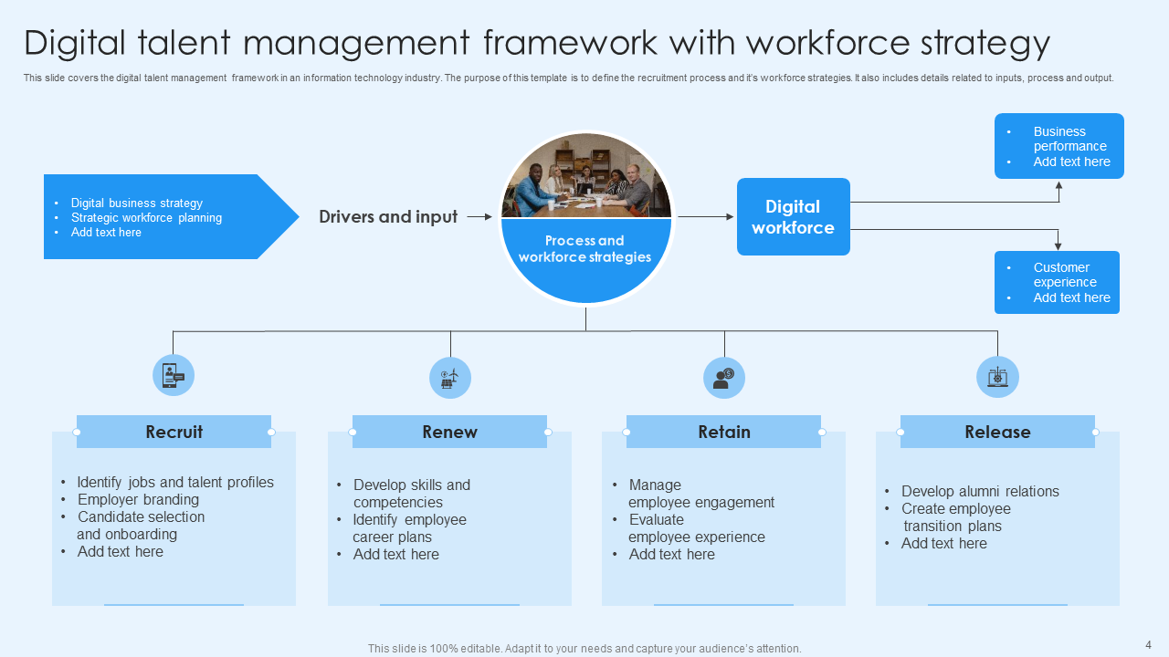
Click Here to Download the Editable Version!

Slide 5
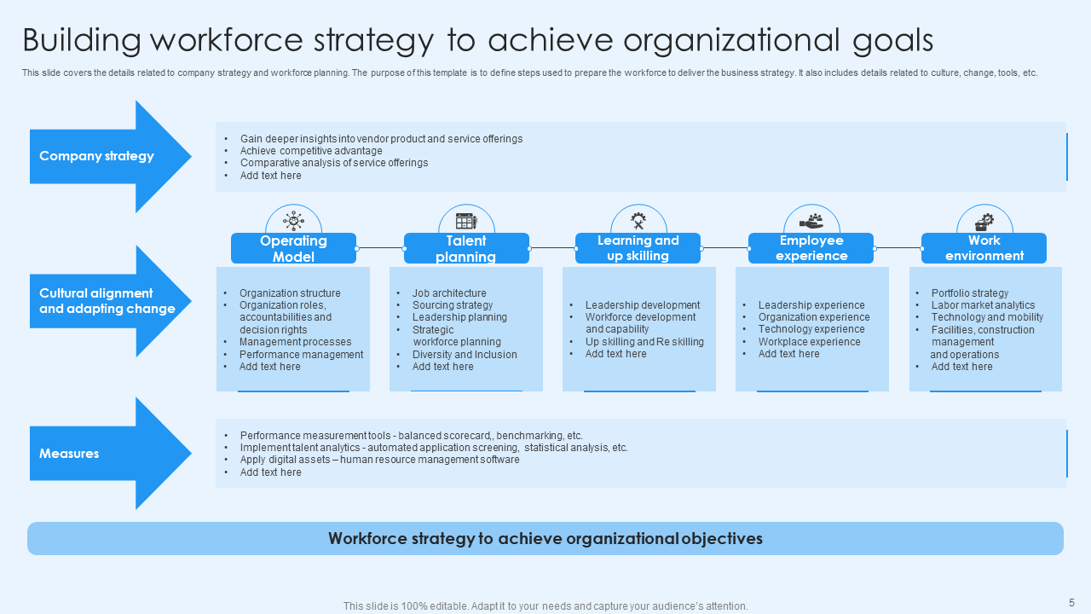
Click Here to Download the Editable Version!

Slide 6
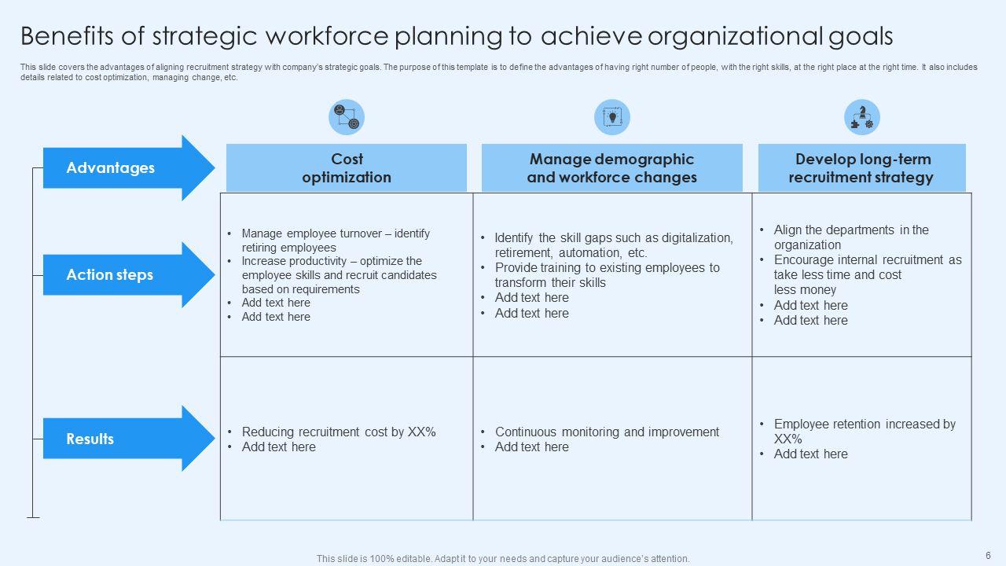
Click Here to Download the Editable Version!

Slide 7
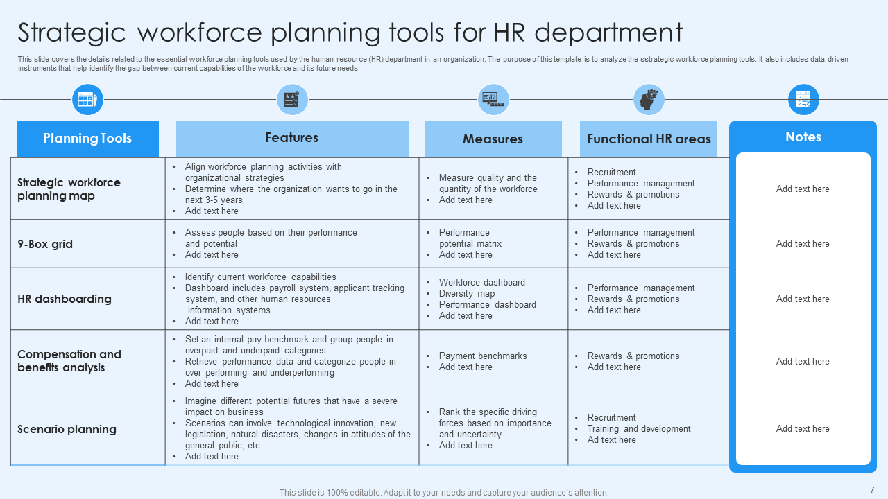
Click Here to Download the Editable Version!

